Slide 1
File Handling
Unit - 3

Slide 2
File Handling
  Read and Write data into file with OutputStream, InputStream, Reader and Writer classes and its sub classes.

Slide 3
Usual Purpose: storing data to ‘nonvolatile‘ devices, e.g. Harddisk
Java I/O (Input and Output) is used to process the input and produce the output based on the input.
Java uses the concept of stream to make I/O operation fast.
Classes provided by package java.io
Data is transferred to devices by ‘streams‘
output - stream
Program
Device
input - stream
Program
Device

Slide 4
A stream is a sequence of data.
Streams in JAVA are Objects.
Streams Having:
  2 types of streams (text / binary) and
  2 directions (input / output)
In Java, 3 streams are created for us automatically.
  System.out : standard output stream
  System.in : standard input stream
  System.err : standard error stream

Slide 5
JAVA distinguishes between 2 types of streams:
Text – streams, containing ‘characters‘
Program
I
‘
M
A
S
T
R
I
N
G
\n
Device
Binary Streams, containing 8 – bit information
Program
01101001
11101101
00000000
Device

Slide 6
InputStream:
  Java application uses an input stream to read data from a source.
  It may be a file, an array, peripheral device or socket.
OutputStream:
  Java application uses an output stream to write data to a destination.
  It may be a file, an array, peripheral device or socket.

Slide 7
4 base-classes dealing with I/O:
  Reader: text-input
  Writer: text-output
  InputStream: byte-input
  OutputStream: byte-output

Slide 8

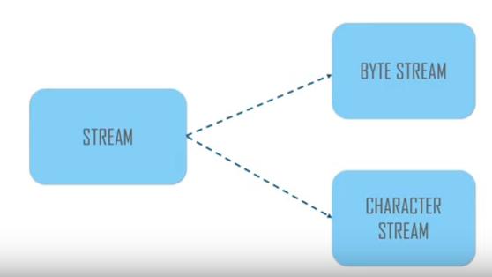

Slide 9

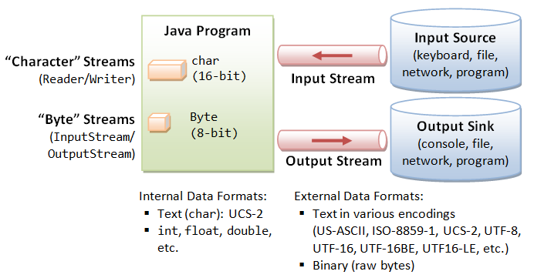

Slide 10

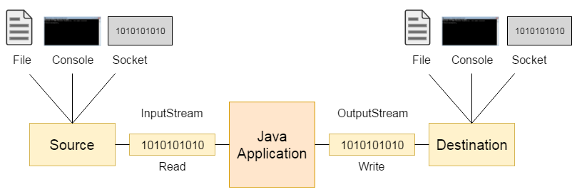

Slide 11

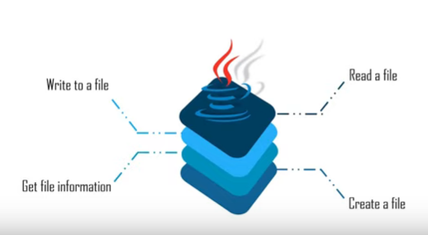

Slide 12

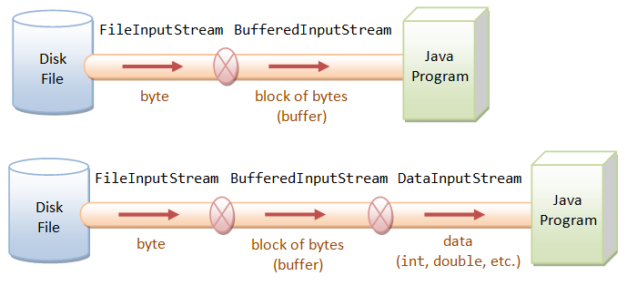

Slide 13

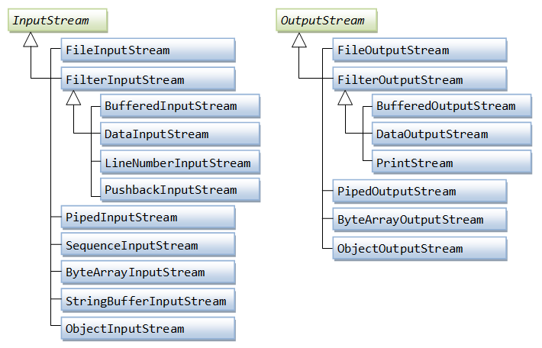

Slide 14

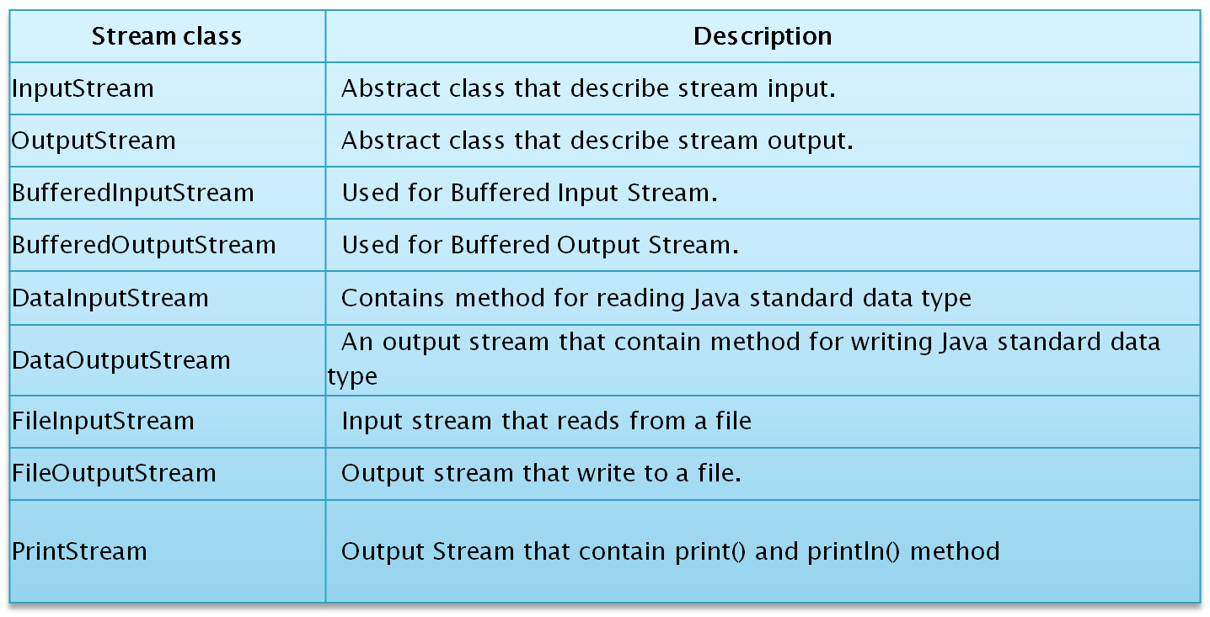

Slide 15

Method | Description
int read()throws IOException | reads the next byte of data from the input stream. It returns -1 at the end of file.
int available()throws IOException | returns an estimate of the number of bytes that can be read from the current input stream.
public void close()throws IOException | is used to close the current input stream.

Slide 16

Method | Description
void write(int)throws IOException | is used to write a byte to the current output stream.
void write(byte[])throws IOException | is used to write an array of byte to the current output stream.
void flush()throws IOException | flushes the current output stream.
void close()throws IOException | is used to close the current output stream.

Slide 17
FileInputStream and FileOutputStream classes are used to read and write data in file
Java FileOutputStream is an output stream for writing data to a file.
FileInputStream class is used for reading streams from file.
For character reading and writing use FileReader & FileWriter class.
FileInputStream Example
FileOutPutStream Example
Copy one file to another file : Example

Slide 18

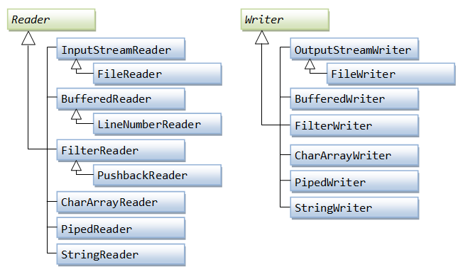

Slide 19
Java FileWriter class is used to write character-oriented data to the file.
This class inherits from the OutputStreamReader class.
Constructors :
  FileWriter(String file)
    creates a new file. It gets file name in string.
  FileWriter(File file)
    creates a new file. It gets file name in File object.
Methods :
  1) public void write(String text)
  2) public void write(char c)
  3) public void write(char[] c)
  4) public void flush()
  5) public void close()

Slide 20
Java FileReader class is used to read data from the file.
This class inherits from the InputStreamReader class.
FileReader is used for reading streams of characters.
Constructors
  FileReader(String filePath)
  FileReader(File fileObj)
Methods:
  public int read():
    returns a character in ASCII form.
    It returns -1 at the end of file.
  public void close():
    closes FileReader.
Example

Slide 21
The PrintStream class provides methods to write data to another stream.
The PrintStream class automatically flushes the data so there is no need to call flush() method.
public void print(boolean b)
public void print(char c)
public void print(char[] c)
public void print(int i) and so on for all data types....
Example

